Slide 1

Efficiency comparison for metaheuristics in solving the Traveling Thief Problem
Filip Mazur
Dawid Ryl
Piotr Neumann

Slide 2
Roadmap
Our goals and motivations
Literature reviews
Results we hope for
What we chose to implement
Our GA module definition

Slide 3

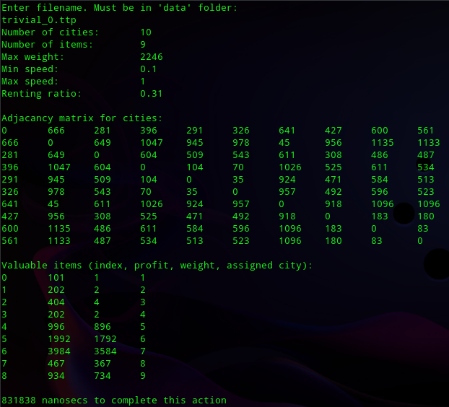



What we chose to implement
What we’ve done so far:
- Loading the data

Slide 4
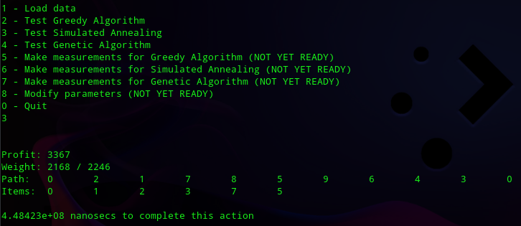
What we chose to implement
What we’ve done so far:
- Simulated Annealing - Greedy for reference - Solution representation

Slide 5
What we chose to implement
What do we plan to do:
Define Genetic Algorithm module
Implement Genetic Algorithm module
Implement measurements-performing units
Define experiment plan
Carry out our experiment

Slide 6
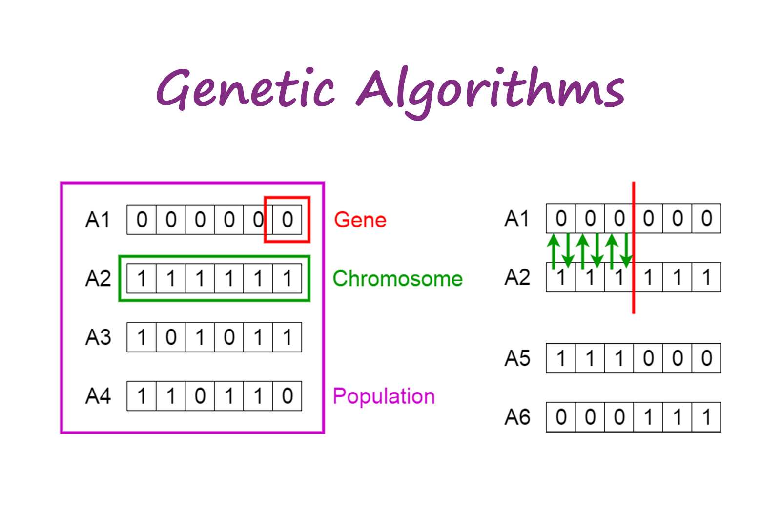
Our Genetic Algorithm module definition
A short recap:
Represent solutions as "chromosomes" which form "population"
Choose fittest specimens (f.e. via "tournament" or "roulette wheel")
Make them mate ( ͡° ͜ʖ ͡°) (f.e. via crossover)
Some children can undergo mutation (f.e. 2 random genes in a child will swap places)
New (usually better than previous) generation arises
Repeat until best solution found (or until bored)
https://towardsdatascience.com/introduction-to-genetic-algorithms-including-example-code-eo-g396e98d8bf3

Slide 7
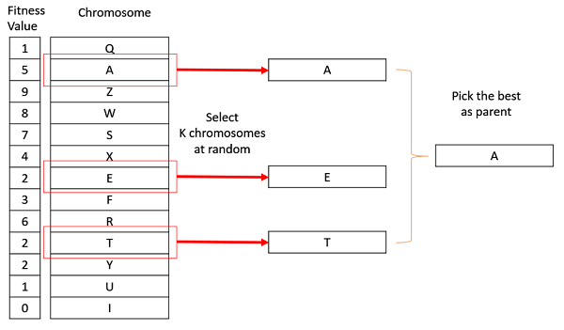
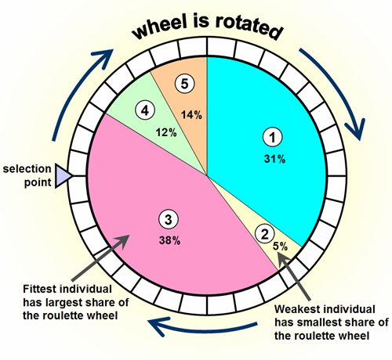
Our Genetic Algorithm module definition
Operators’ definitions
Selection will be based on either tournament or roulette wheel
https://www.geeksforgeeks.org/tournament-selection-ga/
https://www.codewars.com/kata/genetic-algorithm-series-number-5-roulette-wheel-selection

Slide 8
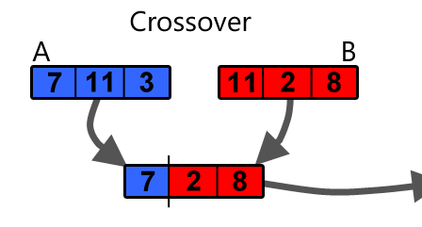
Our Genetic Algorithm module definition
Operators’ definitions
Our one-point-crossover will “cut” both parents in random points and attempt to make a new solution using one half from one parent and second half from the other. If the solution is incorrect it will be fixed.
https://becominghuman.ai/understanding-genetic-algorithms-a-use-case-in-organizational-field-2087c30fb61e

Slide 9
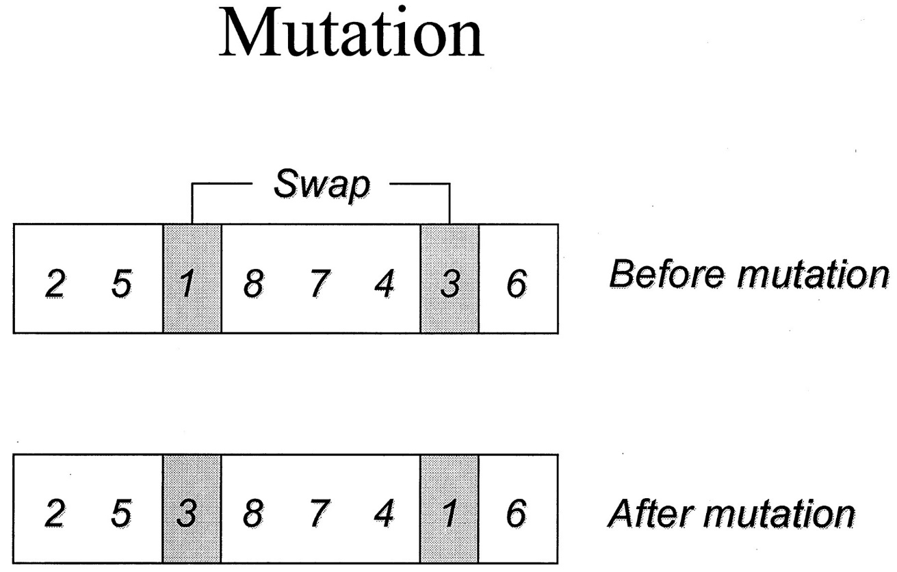
Our Genetic Algorithm module definition
Operators’ definitions
Mutation will swap two random cities in path and will swap some stolen item with some ignored item. If the solution is incorrect (we went over MAX weight) it will be fixed.
http://clinchem.aaccjnls.org/content/47/1/118/tab-figures-data

Slide 10
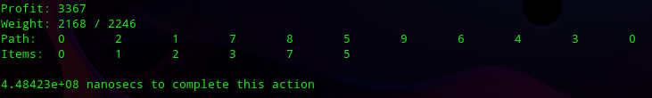
Our Genetic Algorithm module definition
Solution representation
A single member of population will be represented as a pair of two structures:
Path that the Thief took
Items which the thief stole
Solution will be printed exactly as we’ve seen before

Slide 11
Thank You for Your attention!
Filip Mazur
Dawid Ryl
Piotr Neumann

